Slide 1
Building a Reverse Proxy Server Using Fedora Server 40 on Virtual Machines
By: Adrian Magno, Keion Dorsey
Back
Next

Slide 2
Introduction to Reverse Proxy
In this presentation, we will explore the concept of a reverse proxy server. This project demonstrates the setup of a reverse proxy server using Fedora Server 40. It involves configuring NGINX on Server 1 and Apache on Server 2, testing connectivity, setting up security, and ensuring proper server maintenance.
What is a Reverse Proxy?
A reverse proxy is a server that sits between client devices and backend servers. It handles client requests, forwards them to the appropriate server, and returns the server's response. This setup enhances security, load balancing, and caching capabilities.
Back
Next

Slide 3
Server Hardware Requirements
00
CPU / Processor
RAM
C
Mininimum: 1 GHz or Faster Rec: 2 GHz dual-core or faster 64-bit processor
R
Minimum: 1 GB
Rec: 2 GB (4 for hosting applications)
Storage
Network
S
N
Minimum: 10 GB
Rec: 20 GB (Just do 50..)
Minimum: A working NIC with internetaccess

Slide 4
Software Installed
Fedora Server 40
HTTPD Tools (apache)
The OS for both virtual machines
For basic HTTP testing!
01
03
02
04
Virtual Box
NGINX
For virtual machines!
Primary software for our reverse proxy server

Slide 5
Security Configurations
Security Goals | Description | Steps to Accomplish | Result
Password Security | Strong password policies enforced for root and users | Set with the “passwd” command | Secures access to server
Firewall | Only allows HTTP traffic | Configure using the “firewalld” command to open ports 80 (HTTP) | Limits access to only essential services, reducing attack vectors
IP Forwarding | Enables forwarding of network traffic between server interfaces | Modify using /etc/sysctl.conf set net.ipv4.ip_forward=1, apply with sysctl -p | Allows the reverse proxy server to forward requests to the backend server
Security Updates | Ensures that all software packages are up-to-date | Regularly run “dnf update” | Protects against known vulnerabilities and ensures system stability

Slide 6
Network Settings
Reverse Proxy
Web Server
IPv4: 192.168.10.10 | IPv4: 192.168.10.25
Subnet Mask: 255.255.255.0 | Subnet Mask: 255.255.2550
Gateway: N/A | Gateway: N/A
DNS: 8.8.8.8 | DNS: 8.8.8.8
IP Forwarding Enabled: Ensures network traffic is properly forwarded between the two servers.

Slide 7
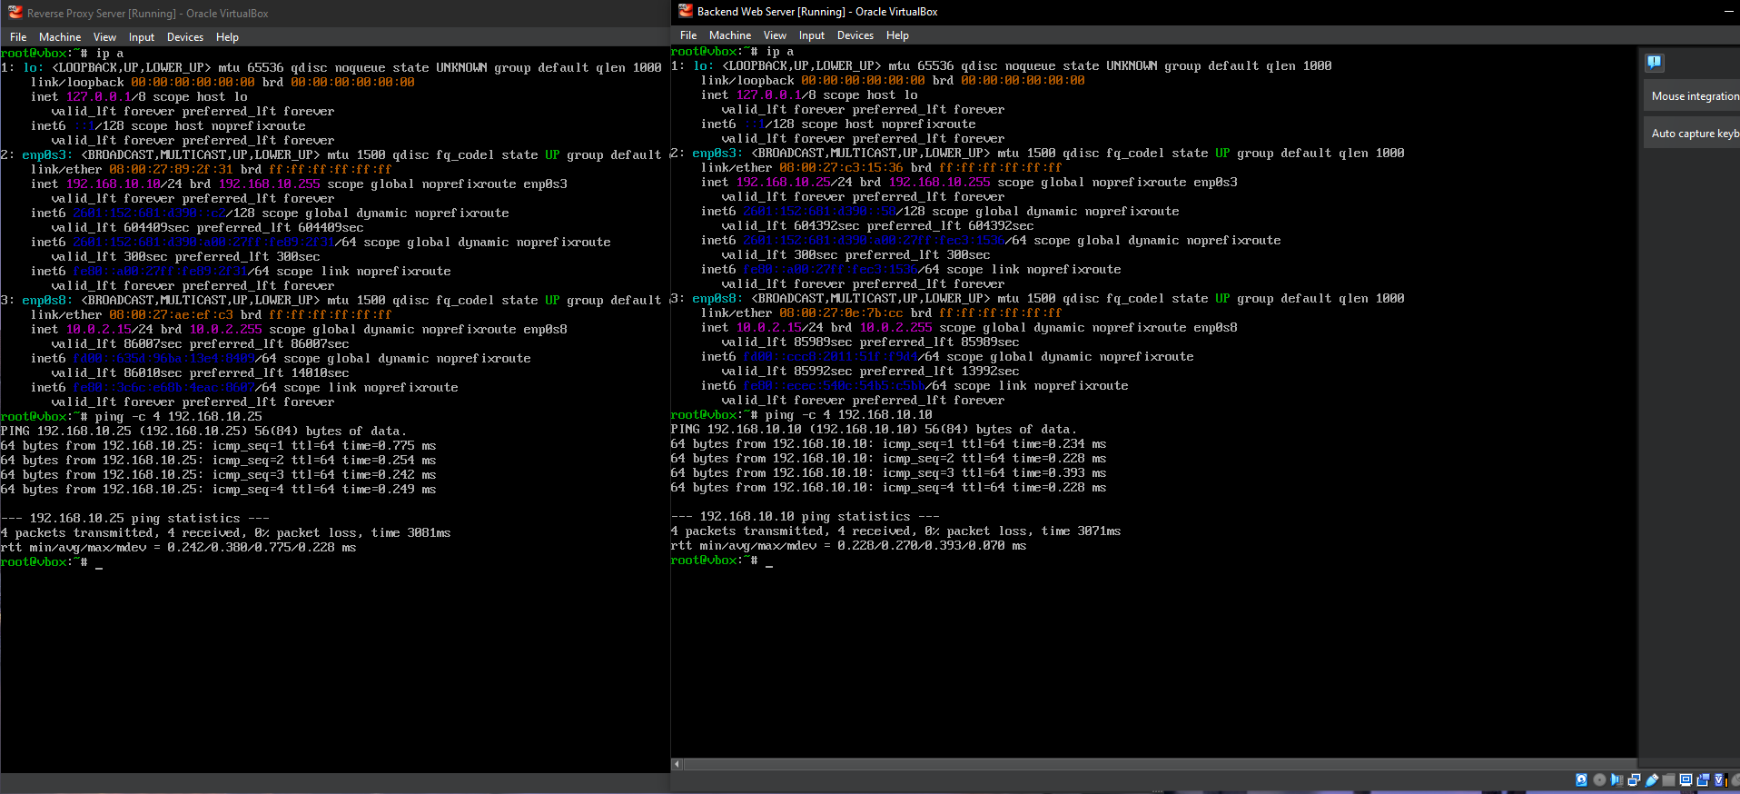

Slide 8
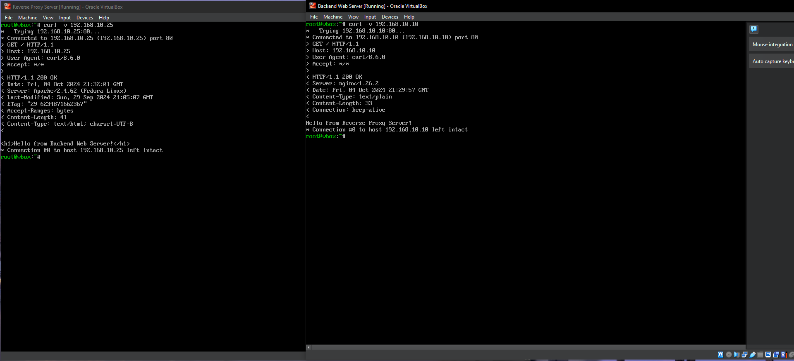

Slide 9
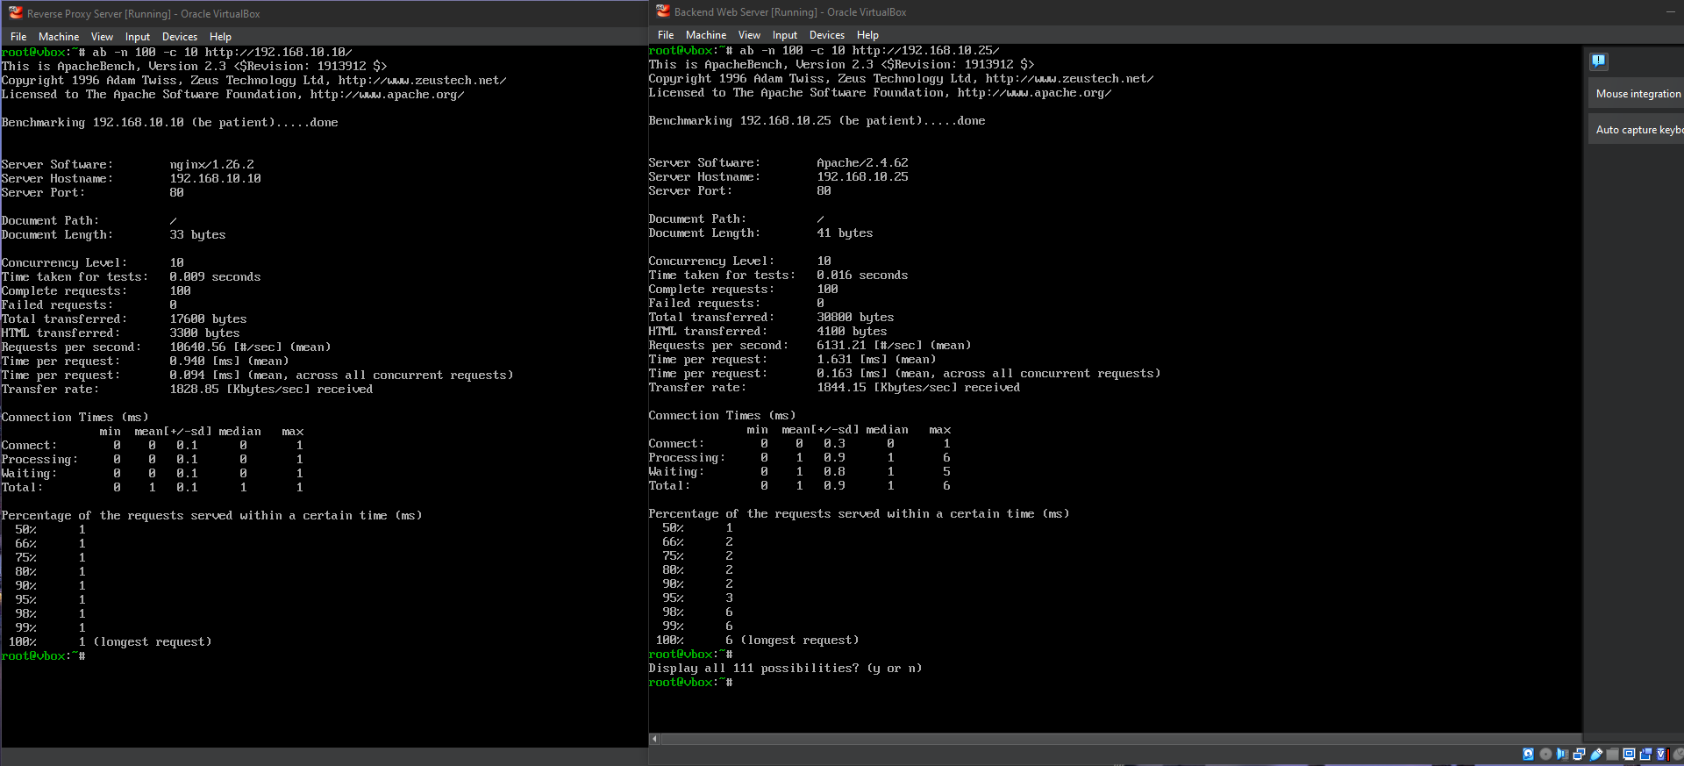

Slide 10
Maintanence and Monitoring
Category | Task | Tools/Commands
Maintenance | Regular system updates | Run “dnf update” to install security patches regularly
Backups | Schedule regular backups | Use “rsync” or any similar tools for backups
Monitoring Resource Usage | Monitor CPU, RAM, and network usage | Use “htop”, “iftop”, or “top” for real-time monitoring
Log monitoring | Review server logs for any issues | Use “journalctl”, “/var/log/” files to detect problems

Slide 11
Troubleshooting?
blank
blank
blank
blank
blank
blank
blank
blank

Slide 12
Lessons Learned
Importance of Planning | Proper planning of hardware and software requirements ensured smooth implementation. Ensuring resources aligned with the project's needs was critical for avoiding issues later.
Configuration Testing | Testing configurations at each step (e.g., NGINX, Apache, firewall) helped catch misconfigurations early, saving troubleshooting time.
Security as a Priority | Setting up strong passwords, firewall rules, and ensuring system updates were vital to protect the server against threats. Security should always be considered at each stage of setup.
Monitoring and Maintenance | Regular monitoring using tools like htop and journalctl ensured early detection of potential issues. Also, establishing a routine for updates and backups was crucial for long-term stability.
Network Troubleshooting Skills | Issues with IP forwarding and firewall rules taught the importance of understanding network flows and using tools like ping and traceroute for diagnosing connectivity issues.

